Slide 1
AGU 2013
IN22A-07 :: The ES-DOC Software Process

Slide 2
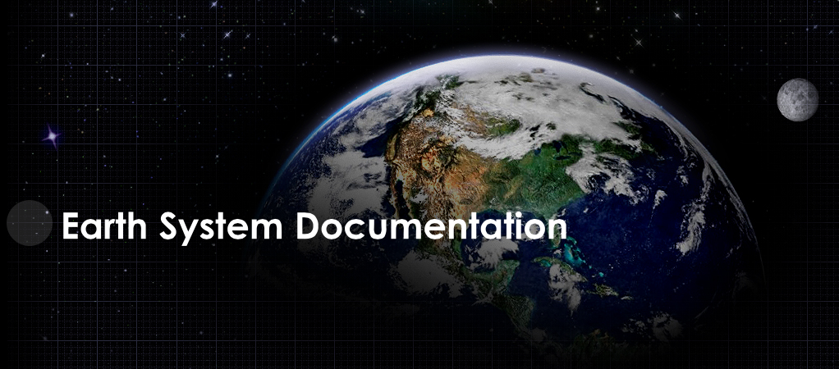


Slide 3
Mission
Nurture a standards based eco-system in support of earth system documentation creation, analysis & dissemination.

Slide 4
http://es-doc.org

Slide 5
#esdocumentation

Slide 6
Funders
IPSL (EU)
NOAA (US)
EX-ARCH (G8)
ISENES-2 (EU)

Slide 7
PI’s
Venkatramani Balaji (US - NOAA)
Cecelia DeLuca (US - NOAA)
Sébastien Denvil (EU - IPSL)
Eric Guilyardi (EU - IPSL)
Bryan Lawrence (EU - BADC)
Karl Taylor (US - PCMDI)

Slide 8
Core Team
Sylvia Murphy (US - NOAA)
Allyn Treshansky (US - NOAA)
Mark Greenslade (EU - IPSL)

Slide 9
Domains
@2013 :: Earth System Models
@2014 ? :: Earth System Observations

Slide 10
Online Presence
Splash Page
Quick Links
Tools
API

Slide 11
Demo
CMIP5 Comparator

Slide 12
Process
Social
vs
Technical

Slide 13
Social Process

Slide 14
before software comes dialog

Slide 15
Social Process
Requirements Capture
scientist engagement
prioritization
scoping
politics

Slide 16
Social Process
Self Organization
roles
responsibilities
mutual respect

Slide 17
Social Process
Transparency
visibilty
accountability
traceability

Slide 18
Social Process
Ethos
commitment to quality
determination
sense of humor !

Slide 19
Social Process
Communication (internal)
face to face
telcos
wiki
email

Slide 20
Social Process
Communication (external)
advocacy
splash page (see branding)
social media

Slide 21
Social Process
Goals
achievable
collectively decided
iterative

Slide 22
Technical Process

Slide 23
after dialog comes software

Slide 24
Technical Process
Information Architecture
domain driven design
ontologies

Slide 25
Technical Process
Meta-programming
Code generation
Multi-language support
Supports quaility

Slide 26
Technical Process
Map Reduce
700,00 lines of XML
4D array

Slide 27
Technical Process
User Experience
UI first
Usability testing

Slide 28
Technical Process
Web Services
HTTP
REST vs RPC
Encoding (JSON)
Security

Slide 29
Technical Process
Polygot Programming
python
javascript
bash

Slide 30
Technical Process
Testing
Automated Testing
Unit, Functional, Integration
CI Server
Executed upon check in

Slide 31
Technical Process
Deployment
Today: single click
Tomorrow: fully automated

Slide 32
Conclusions

Slide 33
Conclusion - 1
Scripter Developer Engineer Architect
In the absence of systematic training, internships, & mentoring, scientists will not get beyond developer status

Slide 34
Conclusion - 2
Strong Repeatable Social Process
The social process is undervalued yet once learnt is transferable between projects

Slide 35
Disclaimer

Slide 36
I am not a scientist !

